Slide 1
Use Data Science to Boost Job Searching
Jonathan Liu

Slide 2
Job Searching is A Full Time Job
Learn about job market
Industries
Employers
Skills
Resume polishing
Relevant Keywords

Slide 3






Job Description
LinkedIn Job Listing
Feature Extraction
Job Detail

Slide 4
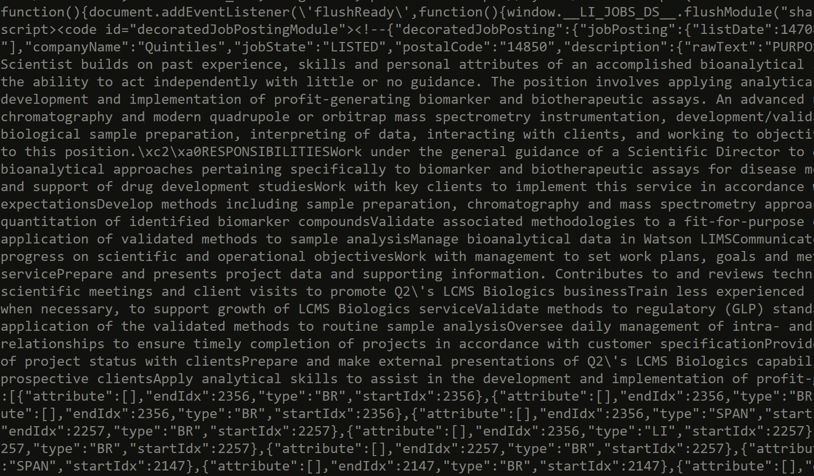

Slide 5

Job Function
Company Industry
Post Date
Description

Slide 6
Quick Insights

Slide 7
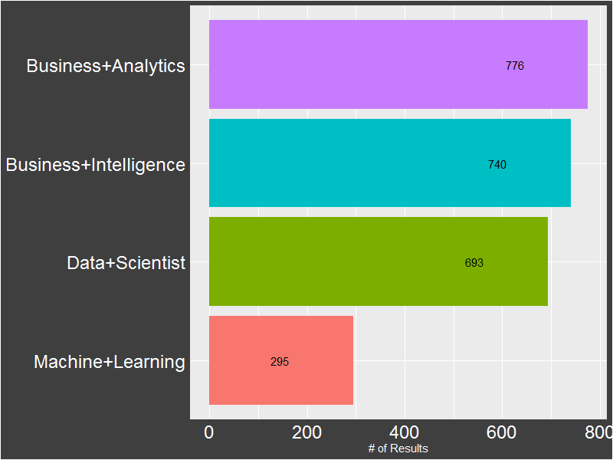
Search Results by Key Words

Slide 8
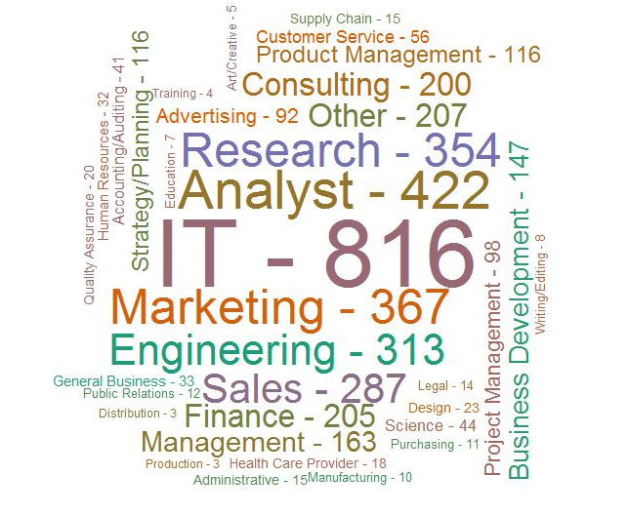
Job Functions

Slide 9
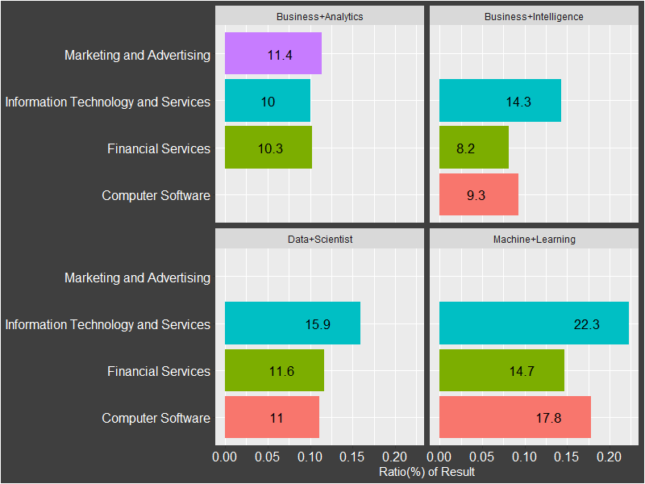
Top 3 Industries by Search Term

Slide 10
What about skills?

Slide 11
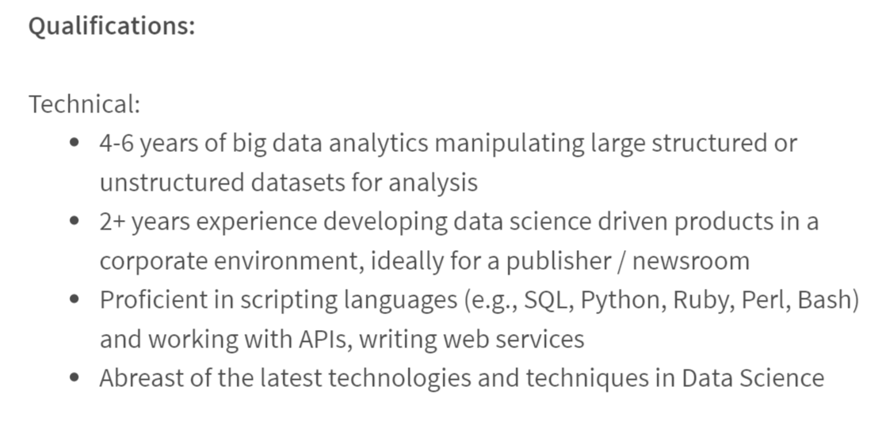
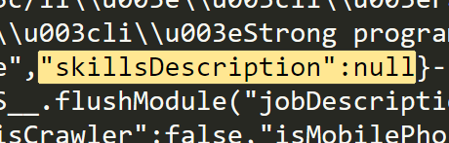

Slide 12
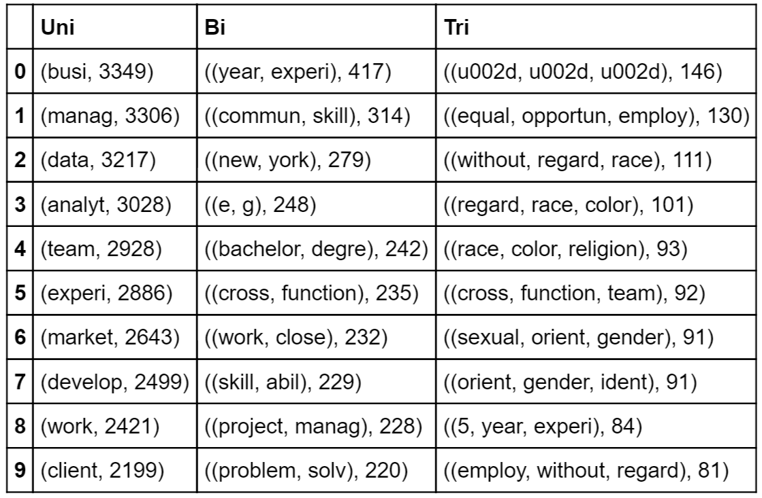
N-grams – Business Analytics

Slide 13
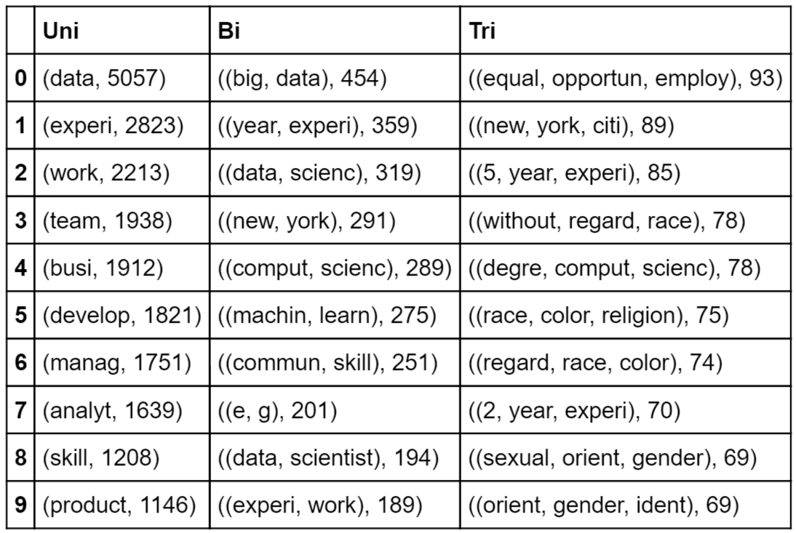
N-grams – Data Scientist

Slide 14
Given my skill set, what is the most relevant keyword (skill) mentioned in job descriptions?

Slide 15
Word2Vec
Scan through documents, n words each time, build shallow neural networks to learn relationship between words “in the window” and “outside of the window”

Slide 16
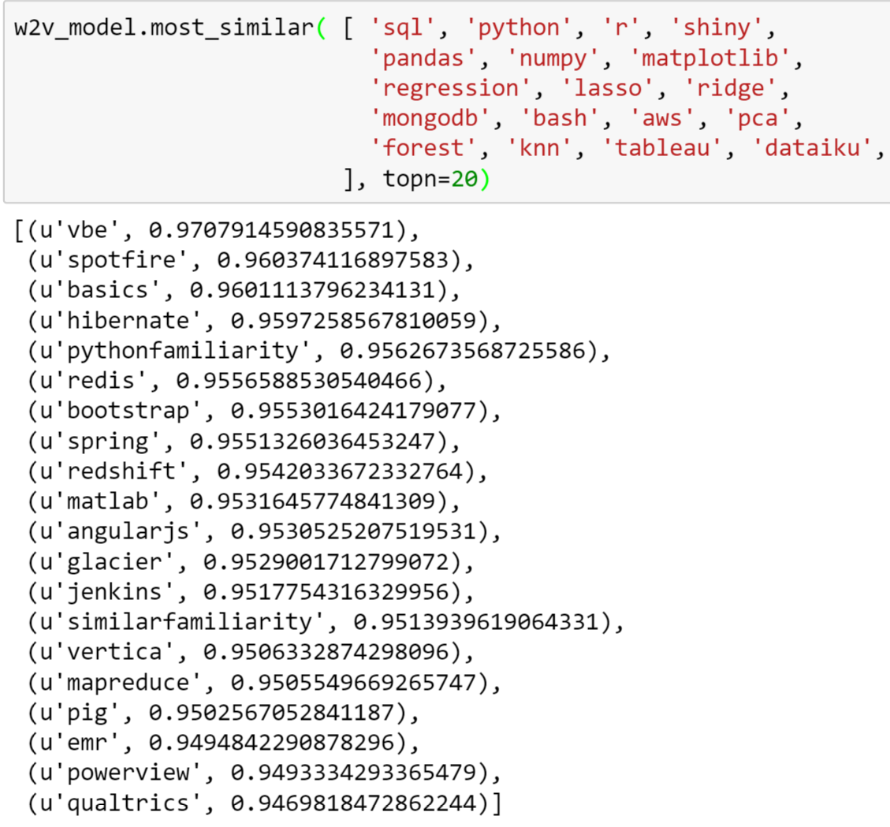

Slide 17
Q & A

